Slide 1
Index
1. Introduction
2. About the Institute
3. Certificate
4. Regression
5. Classification
6. Clustering
7. Association
8. Reinforcement
9. Natural Language Processing
10. Project

Slide 2
Introduction
Machine learning is a field of artificial intelligence that focuses on developing algorithms and models that enable computers to learn from data and make predictions or decisions without being explicitly programmed. The essence of machine learning is to allow machines to improve their performance on a specific task over time by learning from experience, patterns, and relationships within the provided data. It involves the development of mathematical models and algorithms that enable systems to generalize from past experiences and adapt to new, unseen data, ultimately enhancing their ability to perform tasks or make decisions autonomously.

Slide 3
Regression
Regression in machine learning is a type of supervised learning where the goal is to predict a continuous outcome variable based on one or more input features. The outcome variable is also called the dependent variable, while the input features are known as independent variables.
Algorithms:
Linear Regression
Polynomial Regression
Support Vector Regression
Decision Tree Regression

Slide 4
Classification
Classification in machine learning is a type of supervised learning where the goal is to assign predefined labels or categories to input data based on its features. The algorithm learns from labeled training data and generalizes the learned patterns to make predictions on new, unseen data. Classification is widely used in various applications, such as spam detection, image recognition, medical diagnosis, and sentiment analysis.
Algorithms:
Logistic Regression
K-Nearest Neighbors (KNN)
Support Vector Machines (SVM)
Decision Trees
Random Forest

Slide 5
Clustering
Clustering is a type of unsupervised machine learning where the goal is to group similar data points into clusters. Unlike supervised learning, clustering does not have predefined class labels for the data. Instead, the algorithm identifies patterns or structures in the data based on similarities among instances
Algorithms:
K-Means Clustering
Hierarchal clustering

Slide 6
Association
Association rule mining is a technique in machine learning that discovers interesting relationships or associations between variables in large datasets. It's often used in the context of transactional data, where the goal is to find rules that describe patterns of co-occurrence or relationships among items.
Algorithms:
Apriori
Eclat

Slide 7
Reinforcement
Reinforcement Learning (RL) is a type of machine learning paradigm where an agent learns to make decisions by interacting with an environment. The agent receives feedback in the form of rewards or penalties, allowing it to learn the optimal strategy to achieve a goal. RL is often used in scenarios where explicit supervision is not available, and the agent must explore and learn from trial and error.
Algorithms:
Upper confidence bound
Thompson sampling

Slide 8
Project
Noise reduction in audio files
Noise reduction in audio files is a crucial task in various fields such as audio processing, speech recognition, music production, and telecommunications.
Unwanted noise in audio files can degrade the quality of audio recordings, distort speech or music signals, and affect the overall listening experience.
Therefore, effective noise reduction techniques are essential for improving audio quality and enhancing the performance of audio-based applications.

Slide 9
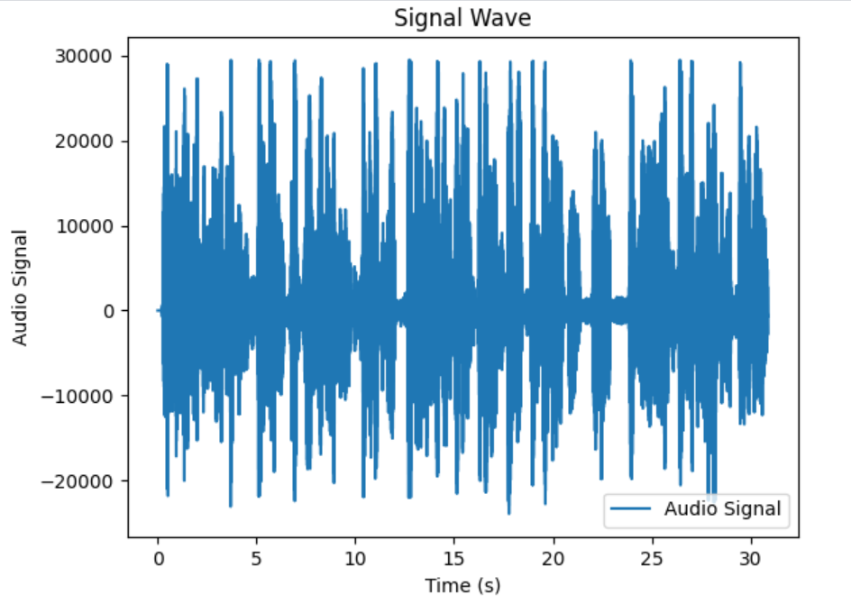
Before

Slide 10
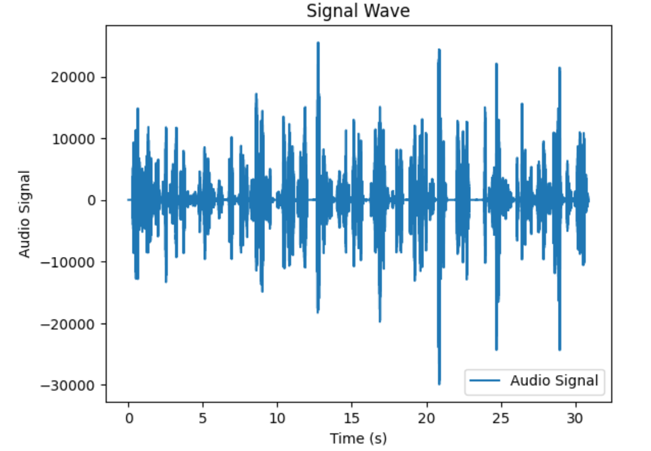
After

